Slide 1
CCC831 2019
Session 10

Slide 2
The normal distribution
It is a continuous probability distribution. Also called Gaussian distribution.
Can be used to approximate discrete distributions, with sufficiently large samples. Can approximate Binomial distribution if np,nq>5
It is symmetrical, bell-shaped in appearance, its interquartile range is from -0.67 standard deviations to +0.67 std.devs.
P(X<X1)=P(X1)
P(X>X1)= 1-P(X1)
To find the probability of the variable being between X1 and X2, P(X1<X<X2)= P(X2)-P(X1).
Probability is calculated based on mean and standard deviation of the distribution

Slide 3
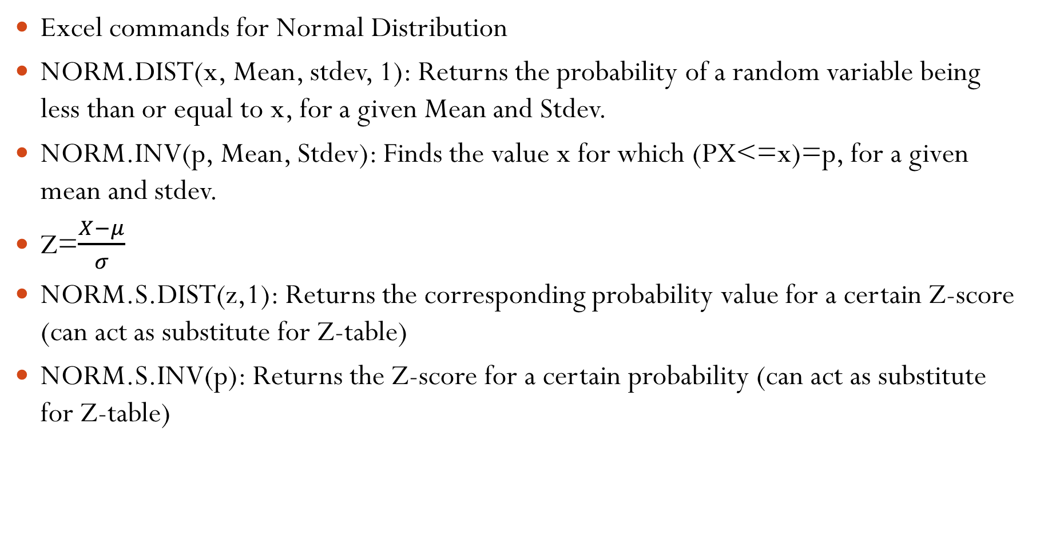
Excel commands for Normal Distribution
NORM.DIST(x, Mean, stdev, 1): Returns the probability of a random variable being less than or equal to x, for a given Mean and Stdev.
NORM.INV(p, Mean, Stdev): Finds the value x for which (PX<=x)=p, for a given mean and stdev.
Z=$\frac{X−μ}{σ}$
NORM.S.DIST(z,1): Returns the corresponding probability value for a certain Z-score (can act as substitute for Z-table)
NORM.S.INV(p): Returns the Z-score for a certain probability (can act as substitute for Z-table)

